Slide 1
Lecture 14: Command Objects & Support for Undo
05-431/631 Software Structures for User Interfaces (SSUI)
Fall, 2020

Slide 2
Logistics
Midterm information is posted
HW 3 mostly graded
Some people’s homework 3 disappeared or stopped working, presumably because they are working on homework 4
This lecture is how to do HW 5

Slide 3

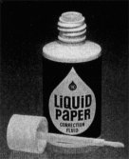
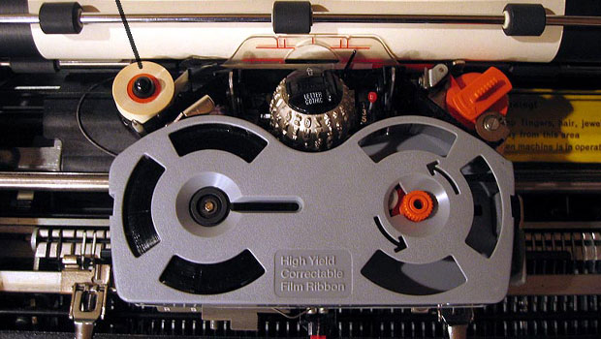
Early Undo
Invented 1951 by Bette Nesmith Graham
IBM Correcting
Selectric II
1973

Slide 4
Computer “Undo”
Undo is reversing a previous operation so that it no longer is in effect
Usually ^Z
For web apps, sometimes the Back button in a browser
Cancel is stopping an operation while it is in progress
Often ESC key or the “Cancel” button in a dialog box

Slide 5
Single Level Undo
create green rect
resize rect
make blue
rotate rect
A
B
C
D
Just toggles the latest item on the list
undo
A
B
C
D
undo
A
B
C
D

Slide 6
Linear Undo
create green rect
resize rect
make blue
rotate rect
1)
2)
3)
4)
5)
A
B
C
D
undo
Keep a list of all operations
Undo (^Z) goes backwards, repeatedly
Redo (^-Shift Z or ^Y) goes forwards after an undo
Undo the undo
New operations remove anything undone – it is lost forever
X
A
B
C
D
undo
undo
X
X
A
B
C
D
undo
X
A
B
C
D
undo
redo
X
X
A
B
C
D
add
shadow
redo
E

Slide 7
Repeat
create green rect
resize rect
make blue
rotate rect
A
B
C
D
Does the previous operation again on the current selection
E.g., rotate something else by the same amount
Really useful
Goes on the undo stack just like normal operations
Typically, uses same shortcut key as Redo
But might want to repeat the previous command after an undo
Office changes icon
Repeat is often not available
repeat
A
B
C
D
E
create green rect
resize rect
make blue
rotate rect
A
B
C
D
undo
A
B
C
D
Repeat make blue
E

Slide 8
Complications: Operations not put on Undo Stack
Scrolling
Might be useful to have a “go back”, like with hyperlinks
See research later
Changing the selection
not undoable, doesn’t change undo stack
My Topaz system made this available for undo – see later
Changing the value of controls, if doesn’t affect any objects
Changing the color of the next-drawn object
Copy (as in Cut-Copy-Paste)
Clipboard changes are not affected by undo
Lots of clever strategies take advantage of this
Also not possible since clipboard is global and undo is per-application
Saving to file is not undoable
Old: blocks off all previous operations
Current: not put on undo stack so can undo past saves

Slide 9
Complications: operations that are collected
Multiple characters typed grouped into one undo
Similarly, multiple backspaces
Used of arrow keys to “nudge” graphics often grouped into 1 operation
Or, one operation causes multiple entries on undo stack: teh_ → the_ (auto-correct; text)

Slide 10
Undo in Various Programs
See details for how Linear Undo works in PowerPoint
Good reference for expected behaviors
Note how selection changes as a result of undo
Many programs have “unusual” designs for undo
Outlook – single level; undo delete – not selected (so hard to find)
PhotoShop – 2 or 3 different undo mechanisms

Slide 11
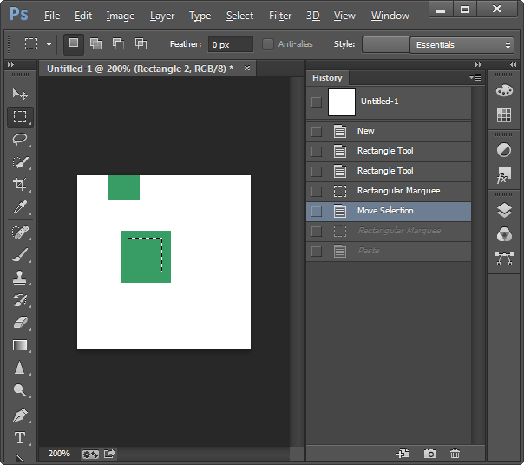
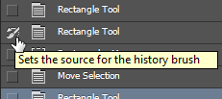
Adobe PhotoShop
History pane displays previous operations
^Z – one-level undo that toggles undo/redo – until V2019
Also Shift-^Z, Alt-^Z - linear undo forwards and backwards
Redo list erased on new operations
“History brush”
Select point in past and brush area – returns to the way it was in the past
Can’t “skip” operations
Is selective by region, but not by time

Slide 12
Undo implementations
Need a central list of operations
Where to store the old values?
With objects that are modified
E.g., a rectangle keeps track of all its former locations
Called “Memento Pattern” (Wikipedia)
But limited in kinds of editors – doesn’t work for text, paint
In a global list
But what to store for each operation?
Using the Command Object pattern
Store in the command object itself
Then it stays with the operation
No confusion about which parameters for which operation

Slide 13

Command Object Pattern
Wikipedia: “An object is used to encapsulate all information needed to perform an action or trigger an event at a later time. This information includes the method name, the object that owns the method and values for the method parameters.”
Was in original “Design Patterns” book (1994)
Better separation between action and widgets
Clearer place to store information needed for undo

Slide 14
HW 5 design for Command Objects
Abstract class that all operations extend: class CommandObject
Methods for Execute, Undo, Redo etc. that specific commands override
Variables for saved values in the command object itself
selectedObject -- object this command affected
value -- new value used by the command
oldValue -- previous (old) value for the object

Slide 15
Example:
create green rect
resize rect
make blue
C
SVG Change fill color: C
Selected obj = rect1
Old value = “green”
New value = “blue”
class ChangeFillColorCommandObject extends CommandObject
A
B
C
undo
rect1

Slide 16
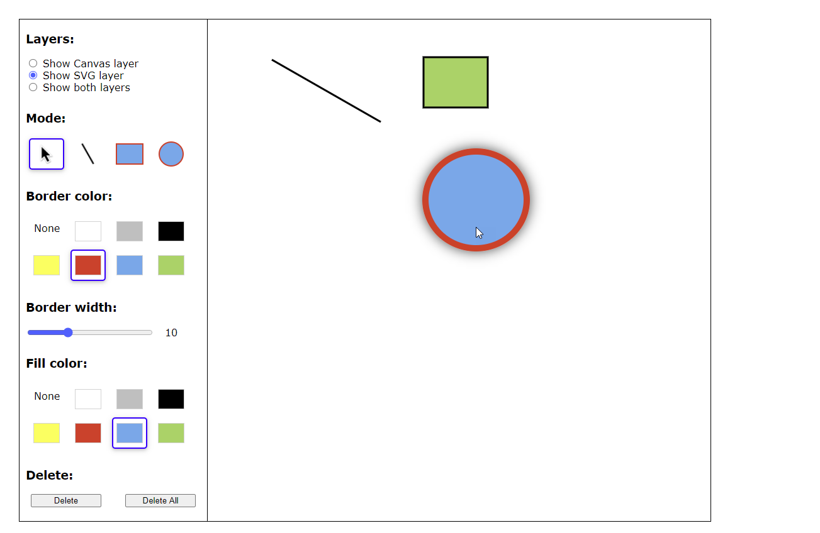
Values
value and oldValue often need to be an object with many values
What to store for create in HW 3?
All values used:
Type (line/rect/ellipse)
Coordinates for create
Border color
Border width
Fill color
For SVG, can store the created object, but not for canvas
Why can’t you just get values from the palette?

Slide 17
Command Object Methods
Execute / Do
The actual operation of the command, like to change the fill color
Gets parameters from the global variables and saves them in the Command Object itself
Real operation will be a little more complicated
execute() {
if (selectedObj !== null) { // global variable for selected
this.selectedObject = selectedObj; // save the object
this.oldValue = selectedObj.fillColor; //get current color
this.newValue = fillColorWidget.currentColor; //new color
selectedObj.fillColor = this.newValue; //actually change
if (addToUndoStack)
this.undoHandler.registerExecution({...this}); //make copy
}
}

Slide 18
Command Object Methods
canExecute – whether the execute method will work now
For change color – just if there is an object selected
(Real method might need to make sure outline and fill aren’t both none)
canExecute() {
return selectedObj !== null;
}

Slide 19
Undo & Redo
Undo method – make the object have its old value
undo() {
this.selectedObject.fillColor = this.oldValue;
// maybe also need to fix the palette to
// show this object's color?
}
Redo = undo the undo
redo() {
this.selectedObject.fillColor = this.newValue;
// maybe also need to fix the palette to
// show this object's color?
}

Slide 20
Repeat
C
Apply same color to the currently selected object
Different object, so might have a different old color
Remember, this operation is added to the undo stack
Note: not the palette’s current color – use saved newColor
repeat() {
if (selectedObj !== null) {
this.selectedObject = selectedObj; // get new selected obj
this.oldValue = selectedObj.fillColor; //obj's current color
// no change to newColor
selectedObj.fillColor = this.newValue; //actually change
if (addToUndoStack)
this.undoHandler.registerExecution({...this});
}
Repeat make blue
E

Slide 21
Change Color Control
Create a new ChangeFillColorCommandObject
Put it in the color widget
Call its execute operation when user clicks on a color

Slide 22
Implementing Undo for Canvas
How can “undraw” an operation for the Canvas?
Just have to save a copy of the canvas before each operation
Redo can perform the operation again – do not need to store both before and after images
What would “repeat” of flood fill mean?
Probably not allowed

Slide 23
Linear Undo Handler
Has to keep the undo stack, and keep track of which operation should be undone / redone / repeat
Methods for
register a command object (after executed)
doUndo – call this when user hits the undo menu item
Undo Available? – controls greying out the undo menu item
doRedo, doRepeat, redo/repeat available?

Slide 24

Advanced: Selective Undo
Reach back into history and select which operation to undo
“Script model”
As if that operation was just removed
Often unclear what this means!
create green rect
resize rect
make blue
rotate rect
1)
2a)
2b)
1x)
A
B
C
D
X
A
B
C
D
undo
X
?
A
B
C
D
create green rect
resize rect
make blue
make red
X
?
A
B
C
D
undo
Notes:
From in class discussion during lecture:
Fusion 360(a CAD software) has it implemented in a pretty cool way…it has a “timeline” at the bottom where you can go back and change things/move the order around
Here’s an image: https://encrypted-tbn0.gstatic.com/images?q=tbn%3AANd9GcR0_aZJRxR3BVD3nsj2IKml89uGhZR3cwJncA&usqp=CAU
(I put the picture above to the left of the slide.)

Slide 25
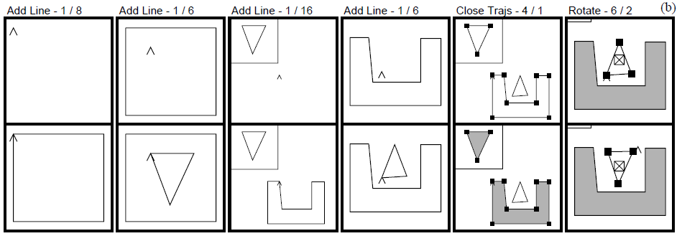
Kurlander’s Graphics Histories
Kurlander, D. and Feiner, S. Editable Graphical Histories. Proc. 1988 IEEE Workshop on Visual Languages. (Pittsburgh, Oct. 10-12, 1988). 127-134. http://ieeexplore.ieee.org/stamp/stamp.jsp?tp=&arnumber=18020&isnumber=662
Video (2:42)
Before and after scenes for each operation
Can undo back to any point
Can then change things and redo the operations afterwards
Basically, the “script” model of undo/redo

Slide 26


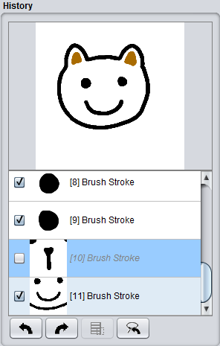
Aquamarine
Brad A. Myers, Ashley Lai, Tam Minh Le, YoungSeok Yoon, Andrew Faulring, Joel Brandt, "Selective Undo Support for Painting Applications", Proceedings CHI'2015: Human Factors in Computing Systems, Seoul, Korea, April 18-23, 2015. pp. 4227-4236. http://dl.acm.org/citation.cfm?doid=2702123.2702543
Allowing Quick Undoing of Any Marks And Repairs to Improve Novel Editing
Selective undo of past operations in a paint program using the script model
Can’t use inverse model in paint because can’t change affected pixels in current context
No dependencies among objects as there are in a drawing program
Issue: spatial dependencies:
Copy and paste
Flood fill (paint bucket)
Short Video: 0:30
Video: 4:35

Slide 27
Selective Undo by Region
Selective Undo by Region
Regular linear undo but only for operations in the region
Avoids the ambiguities
Available in PhotoShop, our research system for code editing in Azurite: YoungSeok Yoon and Brad A. Myers. “Supporting Selective Undo in a Code Editor,” 37th International Conference on Software Engineering, ICSE 2015. Florence, Italy, May 16-24, 2015. 223-233 (volume 1). pdf and video.

Slide 28


Region Conflicts: Flood Fill
Can still have region conflicts
Actions at same place will do different things
Draw some lines
Paint-bucket (flood fill) the area in between
Undo one of the lines in step 1
→ Paints entire background

Slide 29

Direct Selective Undo or Inverse Model
create green rect
resize rect
make blue
rotate rect
1)
2a)
2b)
1x)
A
B
C
D
undo “make blue” = green
Gina: Thomas Berlage. “A Selective Undo Mechanism for Graphical User Interfaces Based on Command Objects,” ACM Transactions on Computer Human Interaction. Sep, 1994. vol. 1, no. 3. pp. 269-294.
Perform inverse of selected operation
Put at end of undo stack
Almost anything can be undone
Meaning determined by what is “useful” and appropriate
undo
A
B
C
D
C’
undo “create” = delete
undo
A
B
C
D
A’
create green rect
resize rect
make blue
make red
undo “make blue” = green
undo
A
B
C
D
C’

Slide 30
Direct Selective Undo Implementation
Implementing direct selective undo not much harder than regular undo:
Allocates a new command object and adds to end of history list
Semantics is based on what the user would want
Undo the operation in a new context means to set the object back to its previous value
Selective Undo is enabled if object is still available
Undo of create is delete
Redo the operation means to set the value of the object again;
redo of create = a new object
Repeat = redo on new object

Slide 31
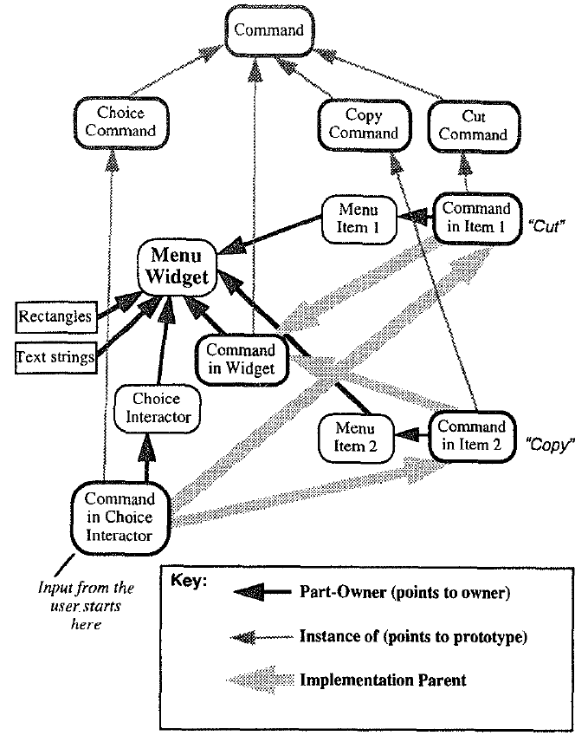
Selective Undo in Amulet
Selective Undo built into Amulet’s Interactor and Command Object system (described in Lecture 5)
Selective Undo was automatically provided
Hierarchical model (see paper) so lower-level commands would trigger higher level

Slide 32

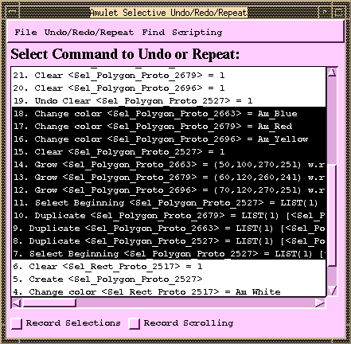
Scripting = “Topaz”
Brad A. Myers. "Scripting Graphical Applications by Demonstration," Proceedings CHI'98: Human Factors in Computing Systems. Los Angeles, CA, April 18-23, 1998. pp. 534-541. ACM DL, or local pdf, and YouTube video or local video (3:09). (Topaz)
Select set of commands and specify that in a program
Uses selective repeat
Can parameterize actions
Moving which object selected is recorded
Forwards, backwards, left, right, up, down, in, out
Search for object of a particular type or value
Little or no change to application if it supports Selective Repeat

Slide 33
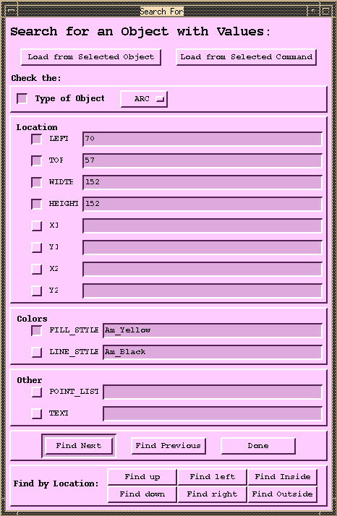
Pictures for Scripting: Object Search

Slide 34
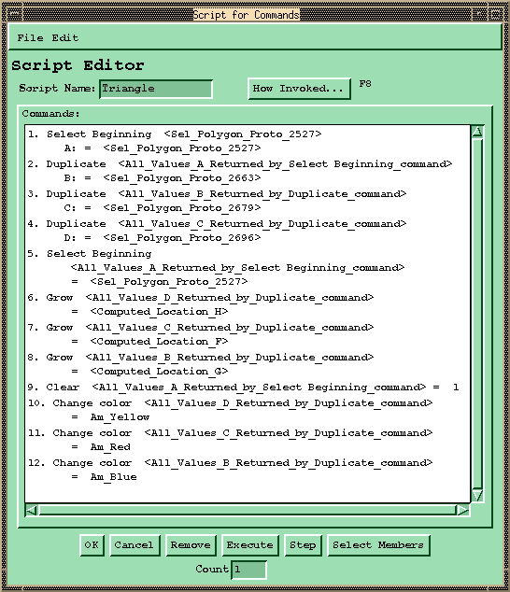
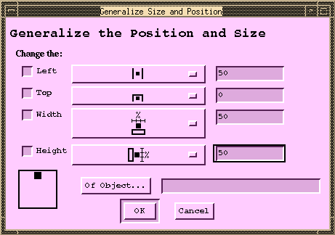
Pictures for Scripting: Generalize Position / Size

Slide 35
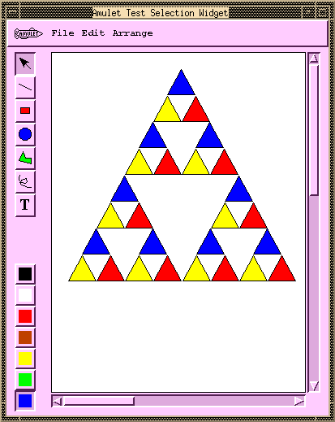
Pictures for Scripting: Result

Slide 36
Multi-User Undo
Required for Google Docs
if multiple users have overlapping selection regions and one user does Undo – what should be done?
Undo the globally last operation
Undo that user’s last operation
Undo the last operation in the region of the user’s cursor
Google Doc is somewhat random
Old research on correct ways to handle this
Summary: it’s complicated for text, easier for graphics

Slide 37
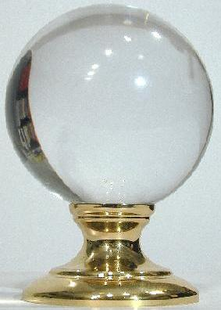
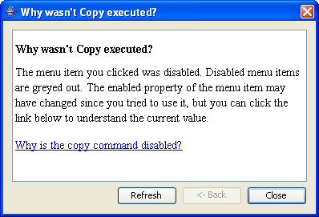
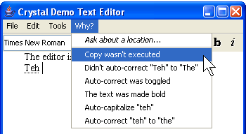
Using Undo History for “Why” Help
Crystal: Clarifications Regarding Your Software using a Toolkit, Architecture and Language
Brad Myers, David A. Weitzman, Andrew J. Ko, and Duen Horng Chau, "Answering Why and Why Not Questions in User Interfaces," Proceedings CHI'2006: Human Factors in Computing Systems. Montreal, Canada, April 22-27, 2006. pp. 397-406. pdf. See also YouTube or local video
Help answer why things happen in regular desktop applications
Lots of complexity in powerful features that people generally like
Ask “Why” about what recently happened

Slide 38
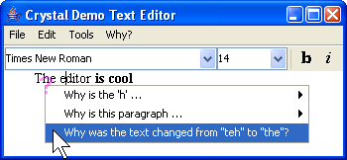
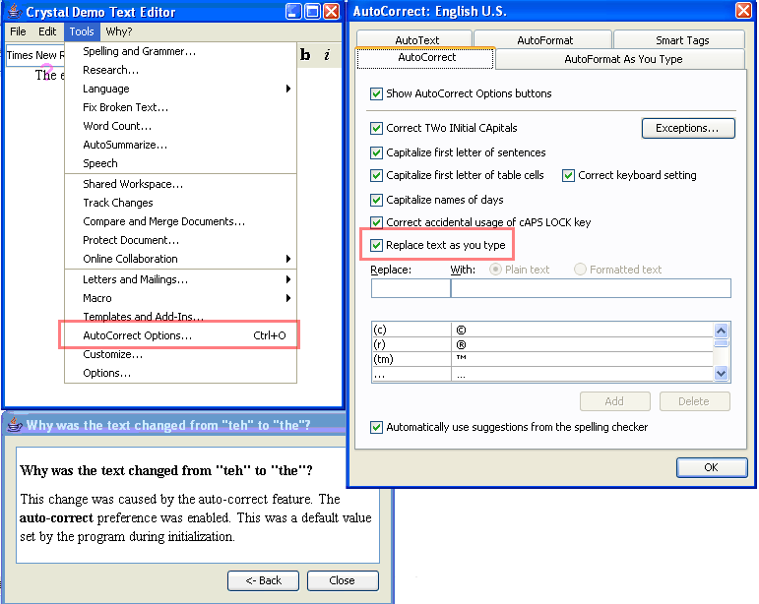
Crystal
Or, ask Why about a location by clicking on objects, or whitespace
Also can explain complexities like style inheritance, etc.

Slide 39
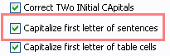
Crystal Implementation Overview
(Full details in the paper)
Only a little more work than supporting Undo
“Command object” architecture for actions
Command objects stored on a list for undo
Programmer adds back pointers from objects to the commands that changed them
Add dependency information for mode variables
Add special commands for actions not executed
Add extra invisible objects for whitespace and deletions

Slide 40
Crystal Implementation, cont.
Crystal framework then builds Why menus and answers automatically
Crystal finds:
Objects under the mouse
Commands that affected those objects
User interface controls involved in those commands
Programmer can annotate some commands to not include in menus
E.g., regular typing
Similar to heuristics for granularity of Undo

